Slide 1

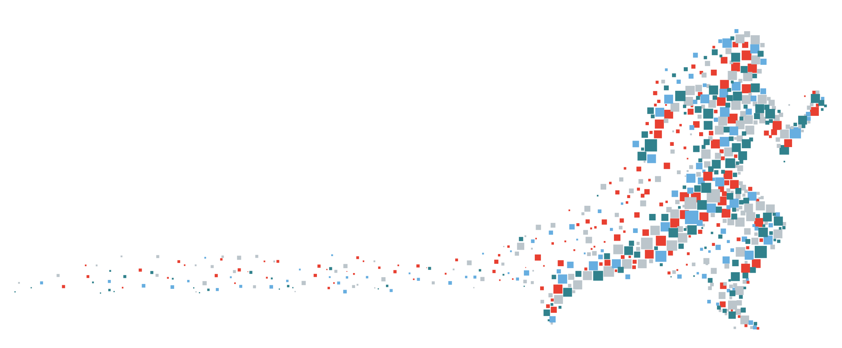




TMS FlexCel: Reporting Everywhere
facebook.com/tmssoftware @tmssoftwarenews @hflickster youtube.com/tmssoftwareTV
Dr. Holger Flick info@tmssoftware.com

Slide 2
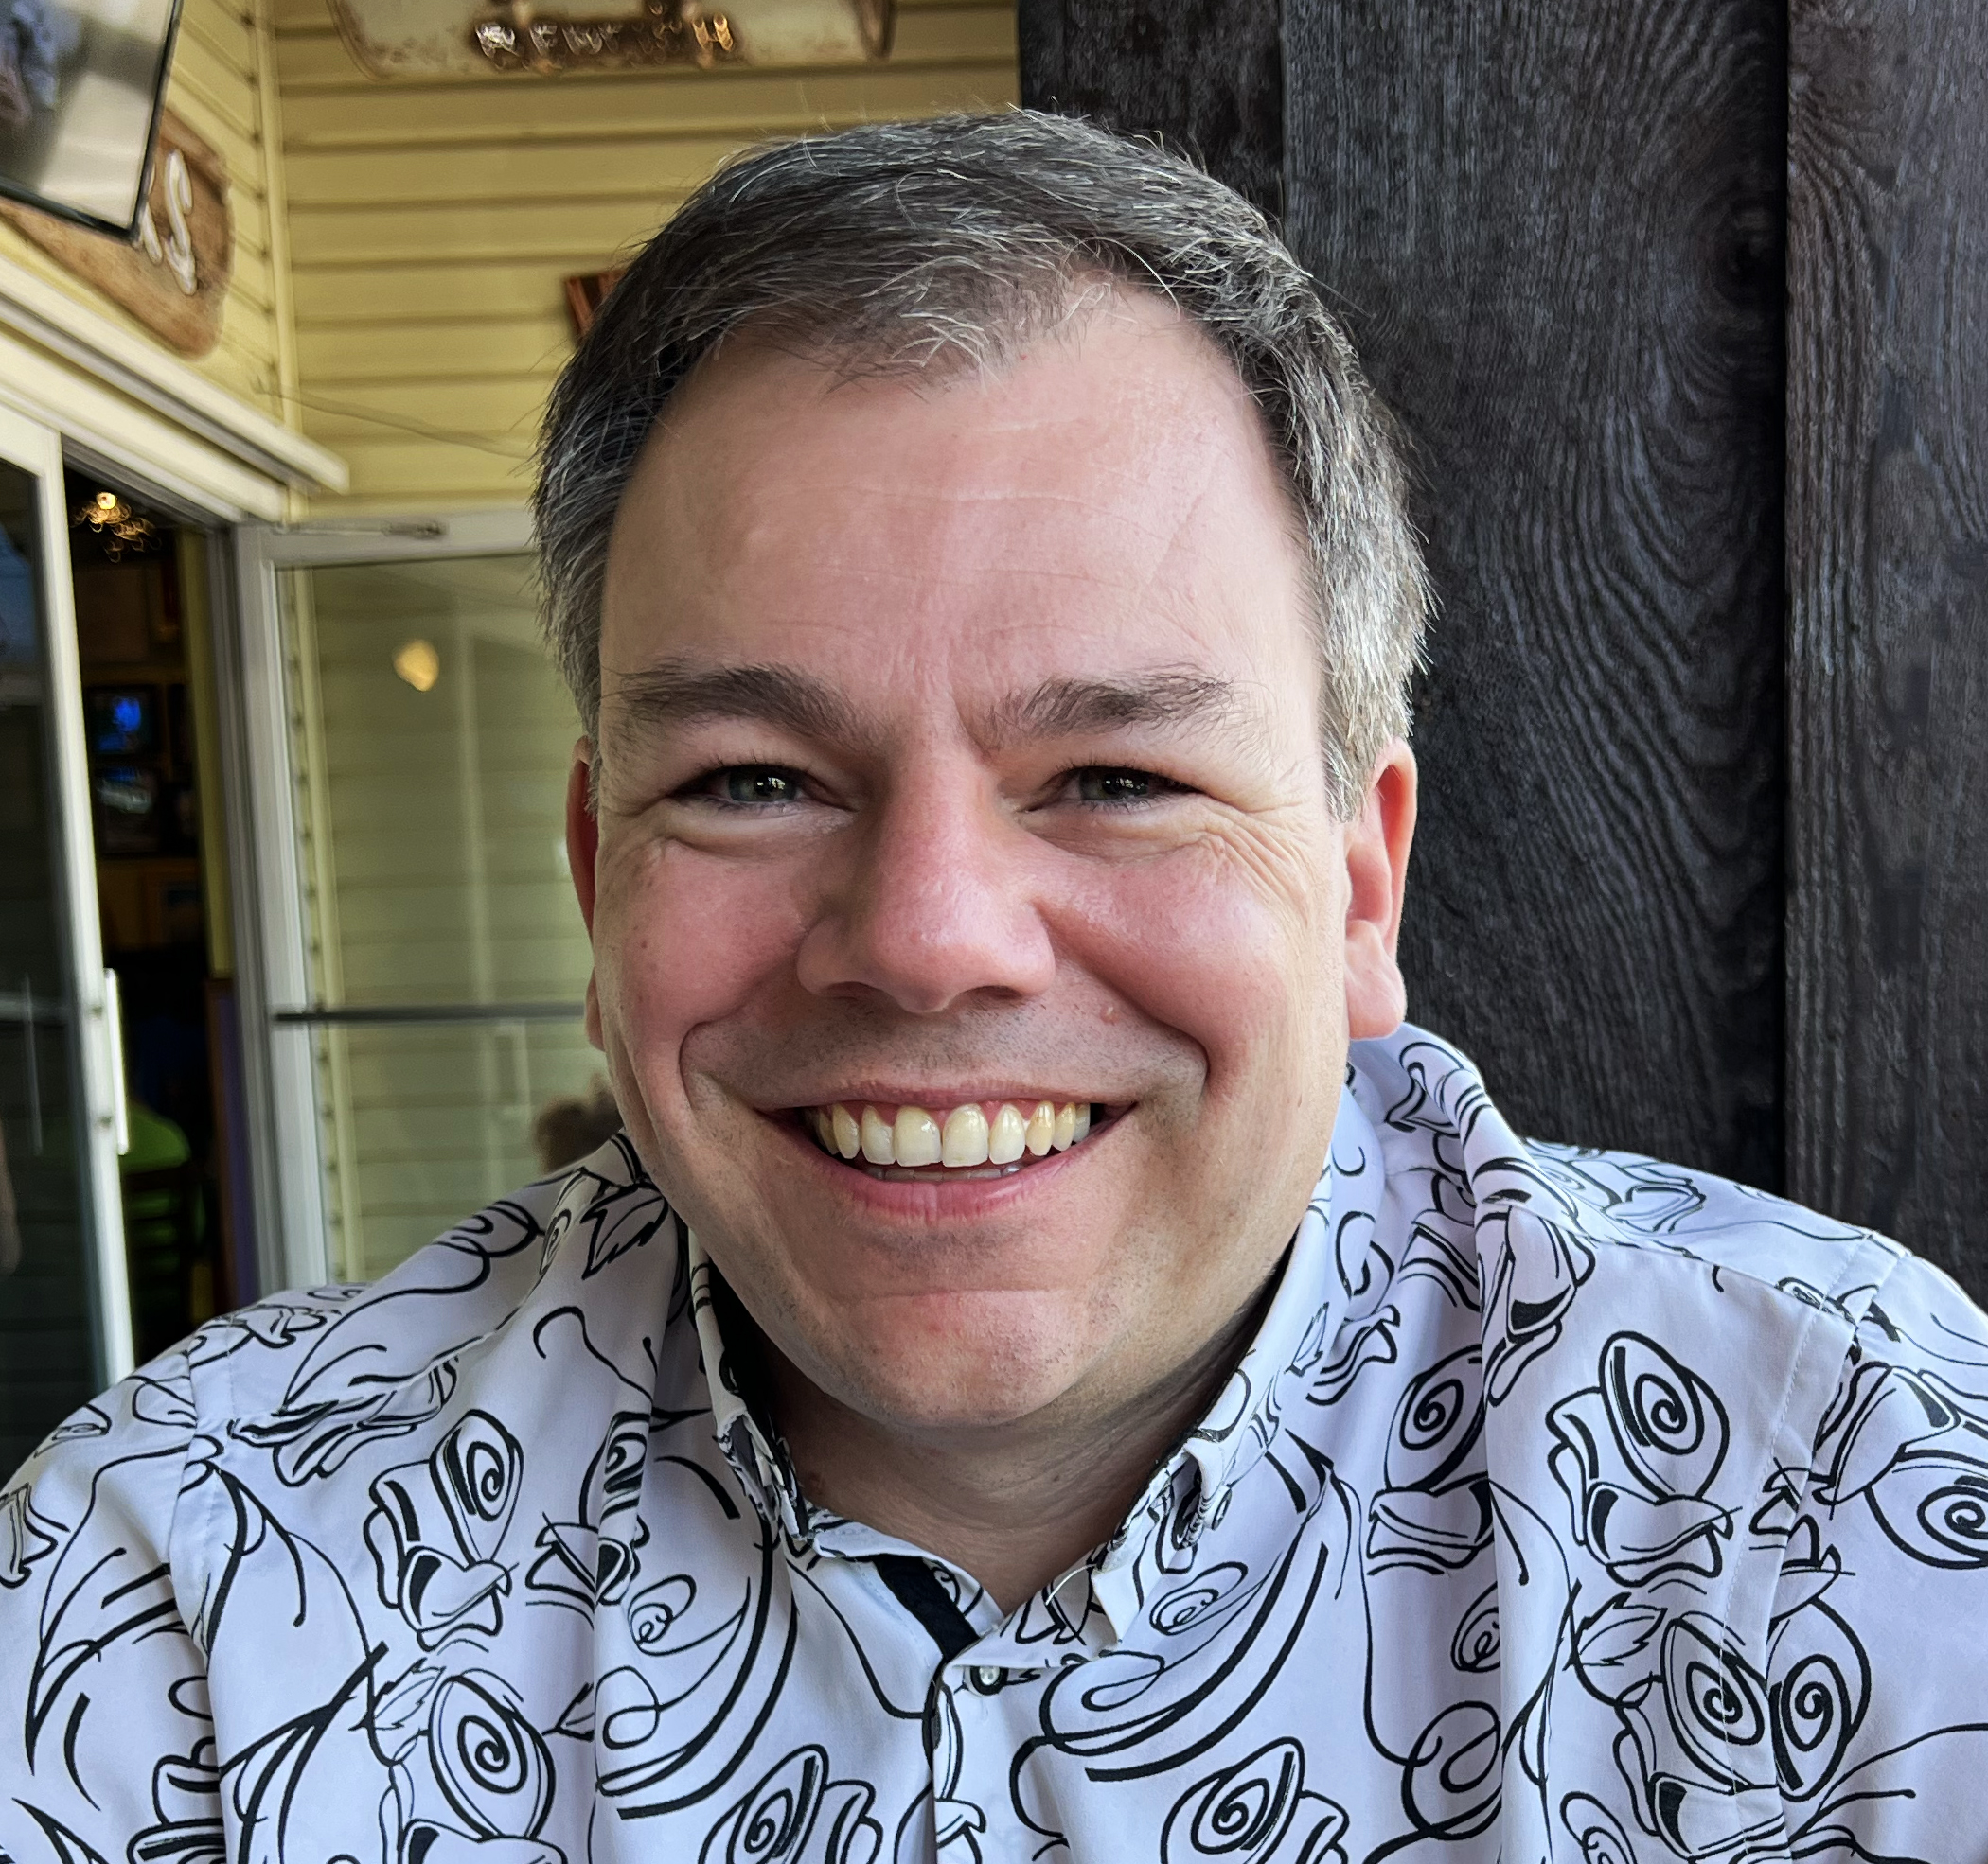
Holger’s CV
Delphi Developer since Delphi 2
Diplom (Master Degree) in Computer Science
Doctorate in Engineering
Borland, CodeGear Delphi Team QA
Embarcadero MVP
GitKraken Ambassador
TMS Chief Evangelist
Bruno’s #1 Cause of High Blood Pressure
Author of several Delphi books

Slide 3
Software Development & Training
holger@flixengineering.com
Offices in United States and Germany

Slide 4


Slide 5


Slide 6
Beware of Demos!
This is not a theoretical session.
This is not a ”sales” session.
Instead, lots of examples will be presented how to make the best use out of Delphi with TMS tools!

Slide 7
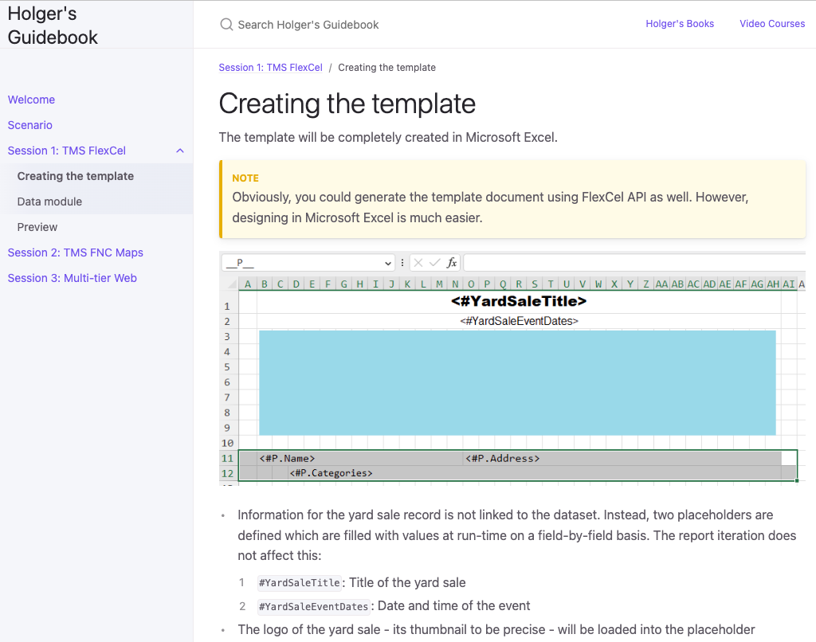
All Infos, Source Code, …

Slide 8
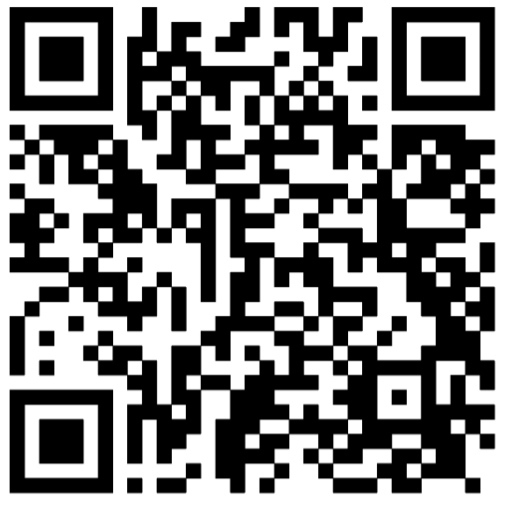
All Infos, Source Code, …
Follow me live
https://tmsdays.flixengineering.freemyip.com/

Slide 9
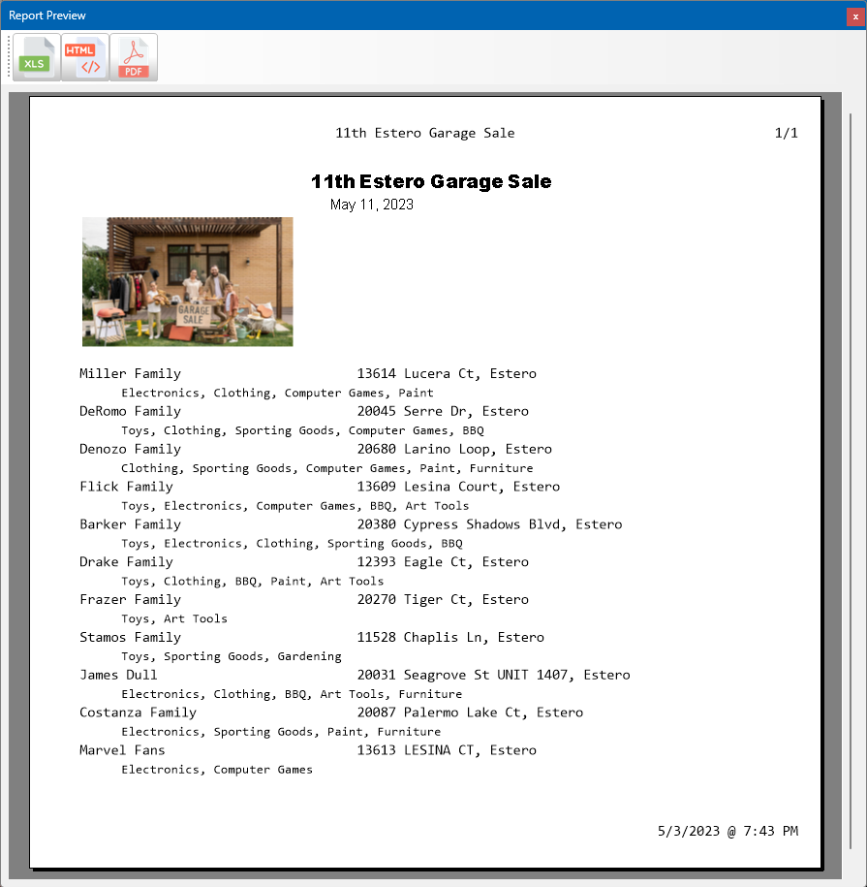
What you will learn

Slide 10
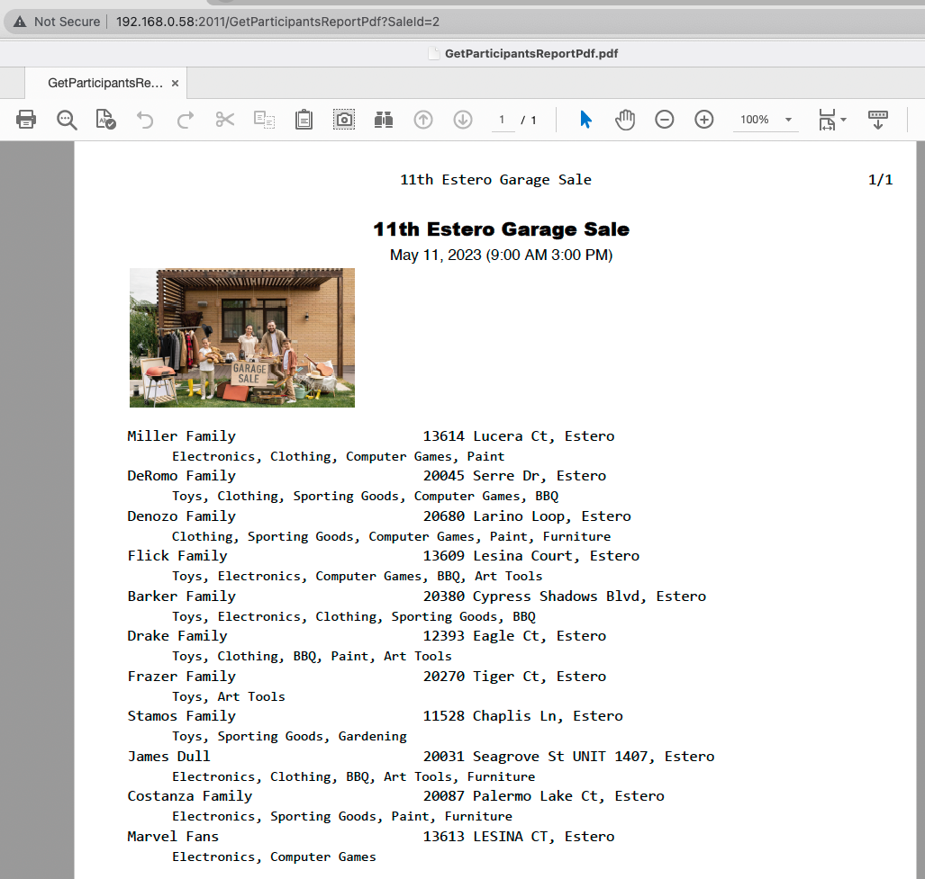
What you will learn

Slide 11

Scenario

Slide 12

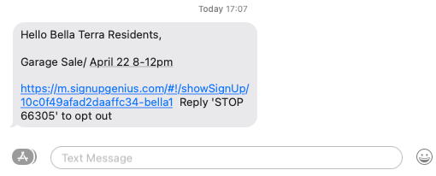
Scenario

Slide 13
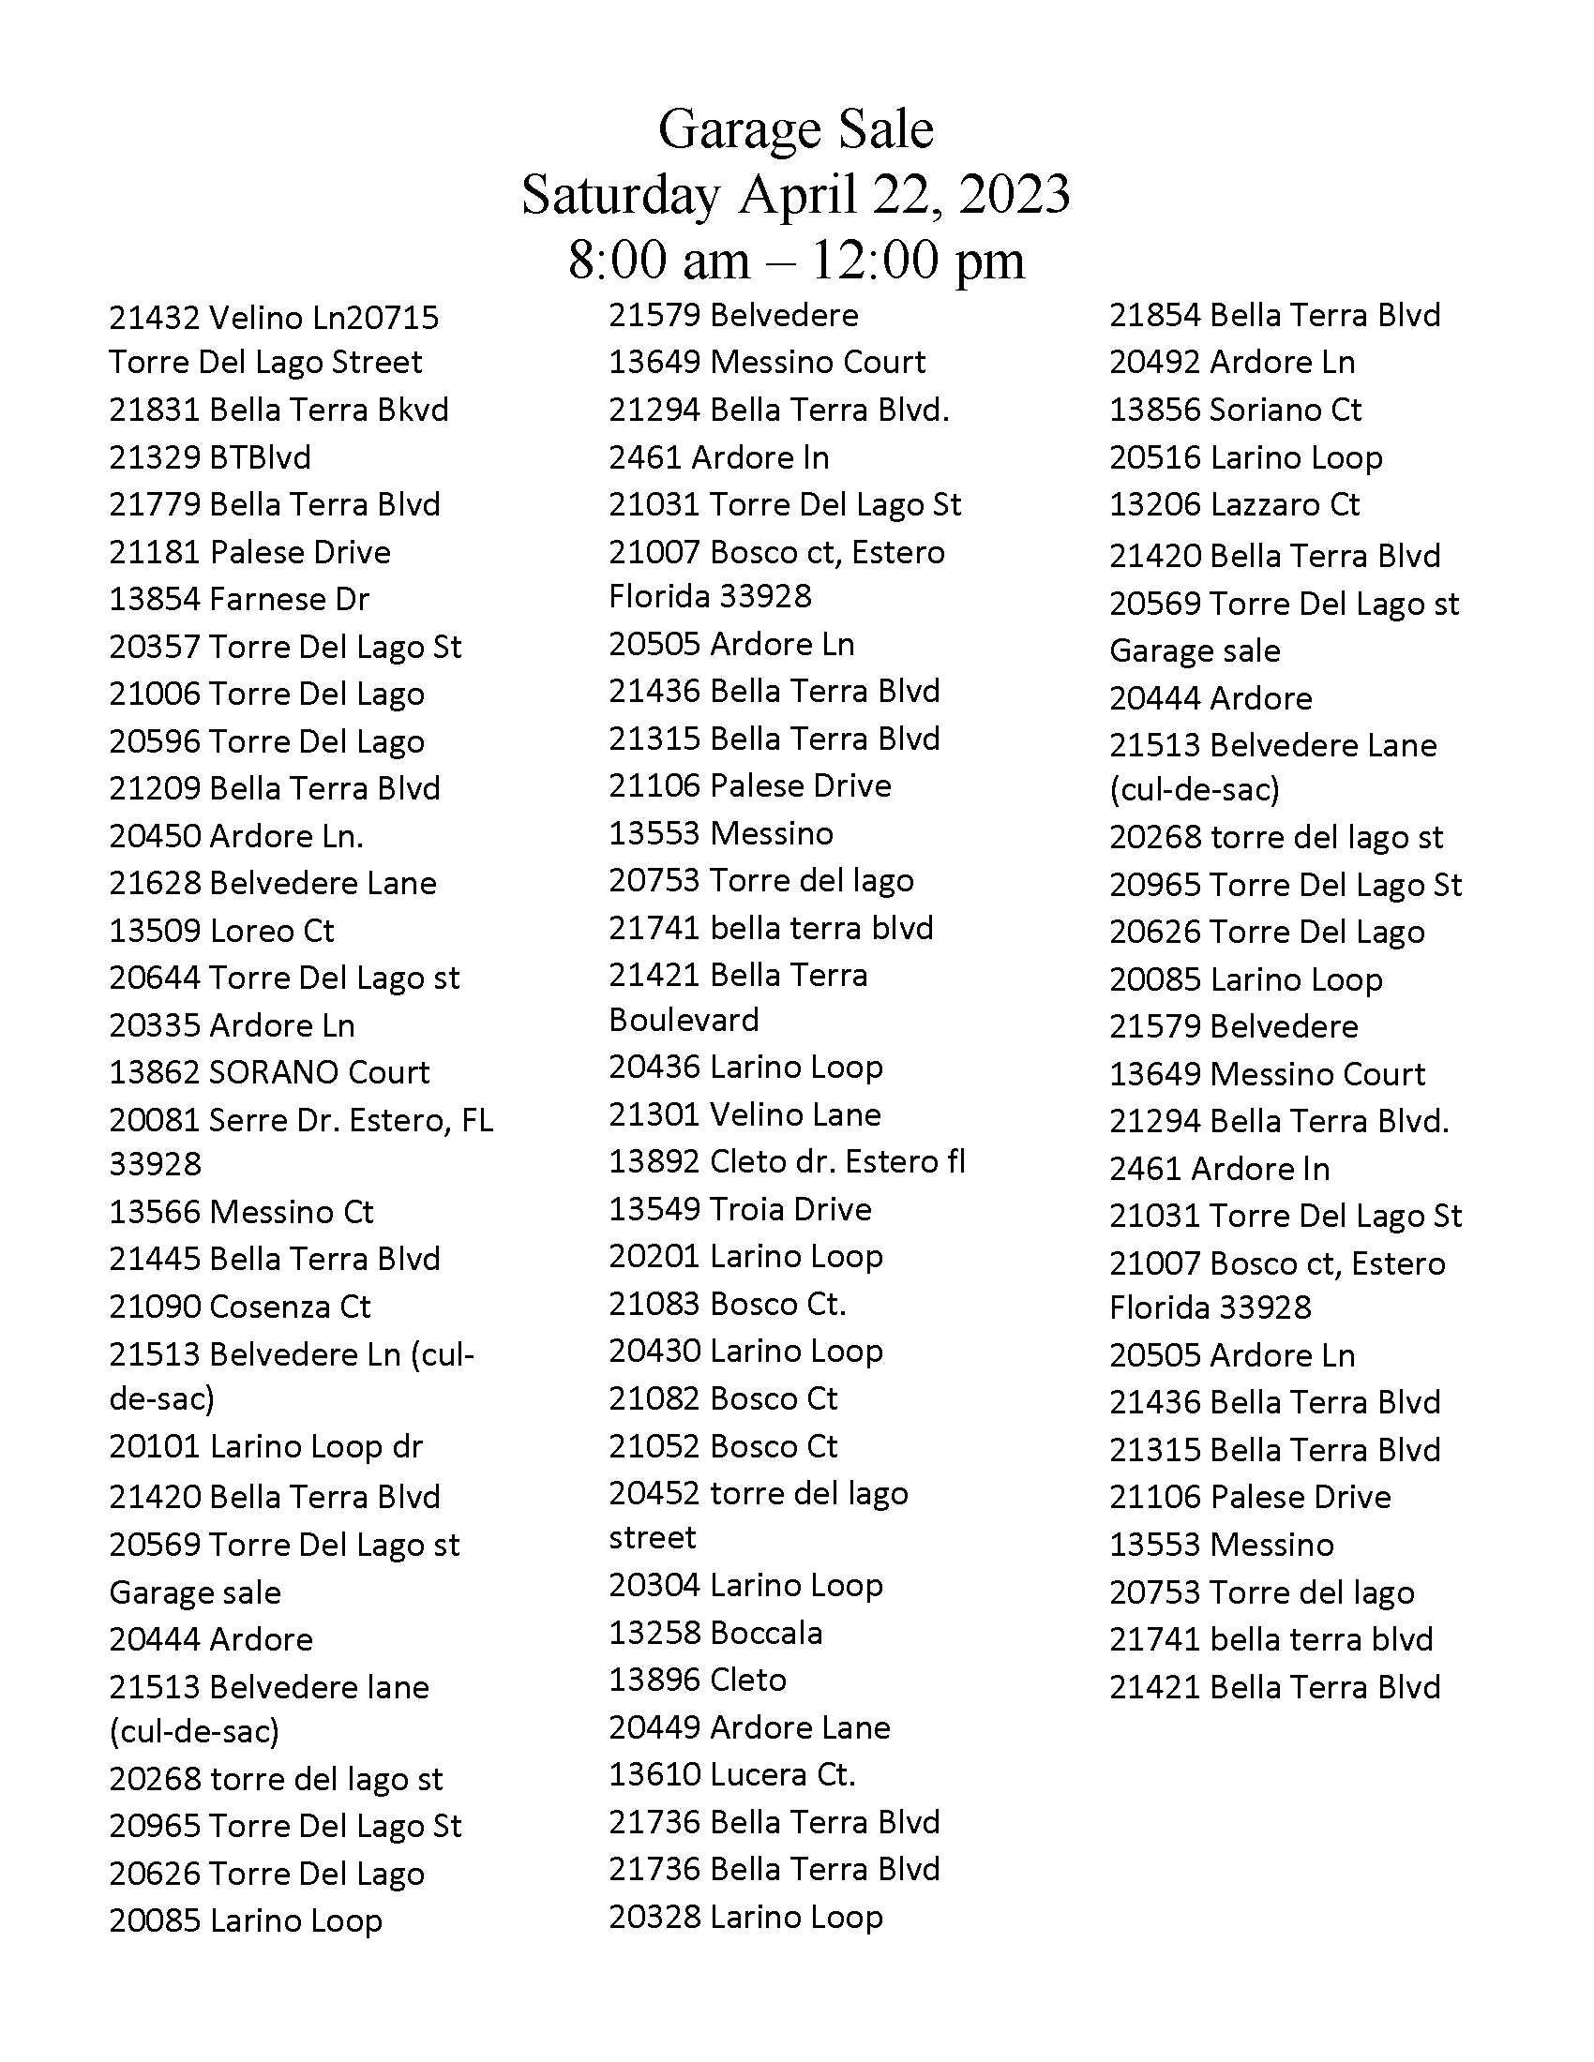
Scenario

Slide 14
Scenario
FlexCel:
Use FireDAC to access a MySQL database
Create a report of all participants with FlexCel
Provide the report as part of a web service
Locate and mark all participants on a map with custom icons

Slide 15
Scenario
FNC Maps:
Locate all participants on a map (geocoding)
Create an optimal route to visit all participants
Create turn-by-turn instructions
TMS WEB Core and XData:
Create a web application that people can use to sign up
Create a web service backend to store and retrieve information for the sign up page
Responsive web design using Bootstrap

Slide 16
